Slide 1
COMPUTER NETWORKS
Chapter 4 The Medium Access Control Sublayer

Slide 2
The MAC Sublayer
Responsible for deciding who sends next on a multi-access link
An important part of the link layer, especially for LANs
Application
Transport
Network
Link
Physical
MAC is in here!

Slide 3
The Medium Access Control Sublayer Chapter 4
The Channel Allocation Problem
Multiple Access Protocols
Ethernet
Wireless LANs
Bluetooth
DOCSIS
Data Link Layer Switching
Summary

Slide 4
The Channel Allocation Problem
Static channel allocation
Assumptions for dynamic channel allocation

Slide 5
Multiple Access Problem
An example: a classroom
Human protocols:
“Give everyone a chance to speak”
“Don’t speak until you are spoken to”
“Don’t monopolize the conversation”
“Raise your hand if you have a question”
“Don’t interrupt when someone is speaking”
“Don’t fall asleep when someone else is talking”
In LANs, WiFi, satellite networks, cocktail party
If more than 2 users send at the same time - collision
All collided packets are lost -> waste of bandwidth
Notes:
鸡尾酒会问题(Cocktail Party Problem)最早是由英国认知科学家Edward Colin Cherry于1953年在研究选择注意机制时提出的一个著名问题, 该问题是说人可以在复杂听觉环境下很容易地将注意力集中在某一个感兴趣的声音刺激上并忽略其它背景声音, 而计算听觉模型却受噪音影响严重.

Slide 6
Static Channel Allocation
Static allocation
For fixed channel and traffic from N users
Divide up bandwidth using FDM, TDM, CDMA, etc.Poor fit to computer systems with extremely bursty data traffic
Performance affected when peak traffic to mean traffic ratios are 1000:1
Most channels will be idle most of the time
Dynamic allocation tries to resolve static allocation problems
gives the channel to a user when they need it.

Slide 7
Assumptions for Dynamic Channel Allocation
Independent traffic
Single channel
Observable collisions
Continuous or slotted time
Carrier sense or no carrier sense

Slide 8
The Medium Access Control Sublayer Chapter 4
The Channel Allocation Problem
Multiple Access Protocols
Ethernet
Wireless LANs
Bluetooth
DOCSIS
Data Link Layer Switching
Summary

Slide 9
Multiple Access Protocols
ALOHA
Carrier Sense Multiple Access
Collision-free protocols
Limited-contention protocols
Wireless LAN protocols

Slide 10
ALOHA
Pure ALOHA
Slotted ALOHA

Slide 11
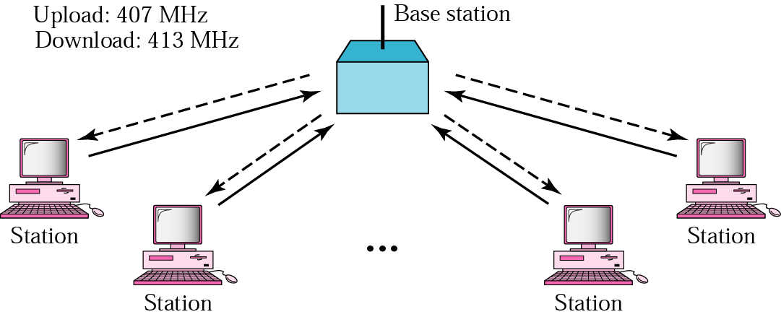
ALOHA Network
Developed by Norm Abramson at the Univ. of Hawaii
the guy had interest in surfing and packet switching
mountainous islands → land-based network difficult to install
fully decentralized protocol
ACK
ACK
ACK
ACK
ALOHA(Additive Link On-Line Hawaii system)
Notes:
ALOHA(Additive Link On-Line Hawaii system)

Slide 12
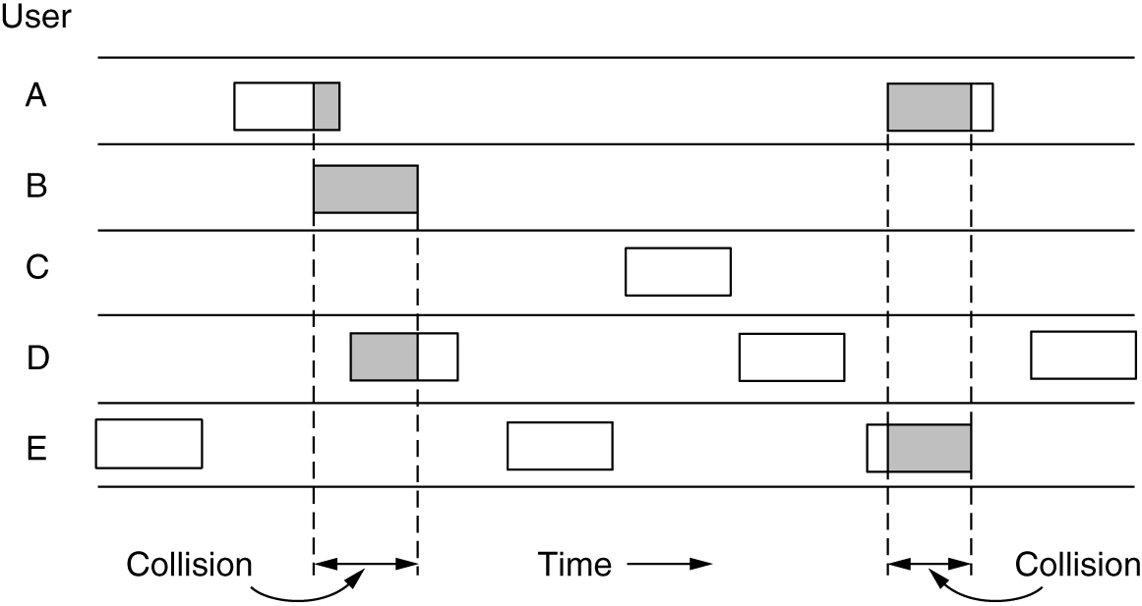
Pure ALOHA
Users transmit frames whenever they have data
Users retry after a random time for collisions
Efficient and low-delay under low load
想说就说
传输之前不侦听信道
即使少量重叠，两帧也彻底破坏
In pure ALOHA, frames are transmitted at completely arbitrary times.

Slide 13
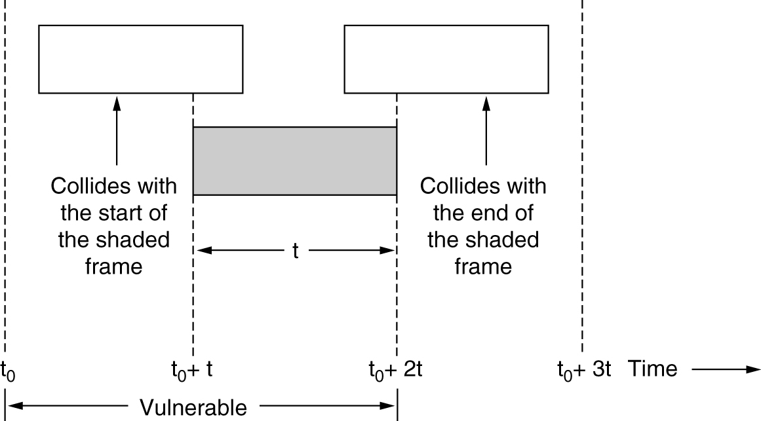
Vulnerable Period（冲突危险周期）
Collisions happen when other users transmit during a vulnerable period that is twice the frame time
Synchronizing senders to slots can reduce collisions
Frame time（帧时）: the frame length divided by the bit rate
Vulnerable period for the shaded frame

Slide 14
Example
A pure ALOHA network transmits 200-bit frames on a shared channel of 200 kbps.
What is the requirement to make this frame collision-free?
Solution
Frame time is 200 bits/200 kbps or 1 ms.
The vulnerable time is 2 × 1 ms = 2 ms.
This means no station should send later than 1 ms before this station starts transmission and no station should start sending during the period (1ms) that this station is sending.

Slide 15
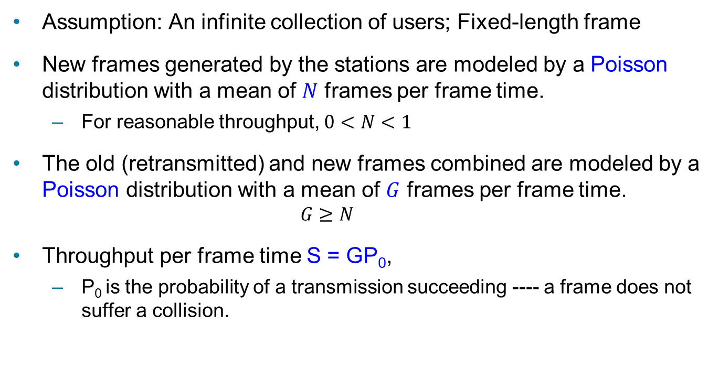
Channel Utilization (1)
Assumption: An infinite collection of users; Fixed-length frame
New frames generated by the stations are modeled by a Poisson distribution with a mean of $N$ frames per frame time.
For reasonable throughput, $0<N<1$
The old (retransmitted) and new frames combined are modeled by a Poisson distribution with a mean of $G$ frames per frame time.
$$G≥N$$
Throughput per frame time S = GP₀,
P₀ is the probability of a transmission succeeding ---- a frame does not suffer a collision.

Slide 16
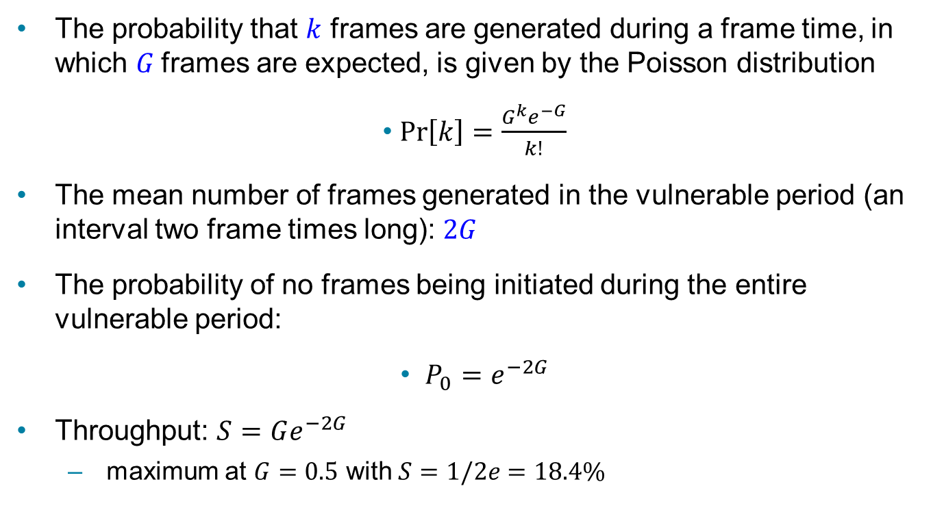
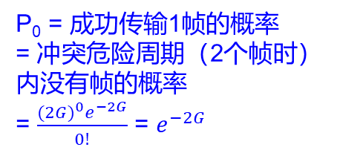
Channel Utilization (2)
The probability that $k$ frames are generated during a frame time, in which $G$frames are expected, is given by the Poisson distribution
$\operatorname{Pr}\left[k\right]=\frac{G^{k}e^{−G}}{k!}$
The mean number of frames generated in the vulnerable period (an interval two frame times long): $2G$
The probability of no frames being initiated during the entire vulnerable period:
$P_{0}=e^{−2G}$
Throughput: $S=Ge^{−2G}$
maximum at $G=0.5$ with $S=1/2e=18.4\%$
P₀ = 成功传输1帧的概率
= 冲突危险周期（2个帧时） 内没有帧的概率
= $\frac{{(2G)}^{0}e^{−2G}}{0!}$ = $e^{−2G}$

Slide 17
Example
A pure ALOHA network transmits 200-bit frames on a shared channel of 200 kbps.
What is the throughput if the system (all stations together) produces
a. 1000 frames per second?
b. 500 frames per second?
c. 250 frames per second?

Slide 18
Solution
The frame time is 200 bits/200 kbps or 1 ms.
a. If the system creates 1000 frames per second, or 1 frame per millisecond, then G = 1. In this case S = G × e^{−2G} = 0.135 (13.5%). This means that the throughput is 1000 × 0.135 = 135 frames. Only 135 frames out of 1000 will probably survive.
b. If the system creates 500 frames per second, or 1/2 frames per millisecond, then G = 1/2. In this case S = G × e^{−2G} = 0.184 (18.4%). This means that the throughput is 500 × 0.184 = 92. Only 92 frames out of 500 will probably survive.
c. If the system creates 250 frames per second, or 1/4 frames per millisecond, then G = 1/4. In this case S = G× e^{−2G} = 0.152 (15.2%). This means that the throughput is 250 × 0.152 = 38. Only 38 frames out of 250 will probably survive

Slide 19
Slotted ALOHA
将时间分为以一个帧时为单位的离散的时间片，每个时间片可以用来发送一个帧。站点有数据发送时，必须等到时间片的开始才能发送
Low load wastes slots, high loads causes collisions. Requires sync of clocks
Applied in Internet access over cable, multiple RFID tags talk to the same RFID reader
Slotted ALOHA is twice as efficient as pure ALOHA
Vulnerable period = 1个帧时。P₀ = e^{-G} ,S = Ge^{-G}
Throughput: maximum at G = 1 with S = 1/e (about 0.368)
P₀ = 成功传输1帧的概率 = 冲突危险周期（1个帧时）内没有帧的概率 = $\frac{{(G)}^{0}e^{−G}}{0!}$ = $e^{−G}$

Slide 20
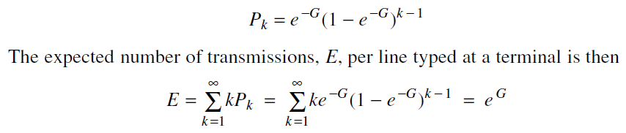
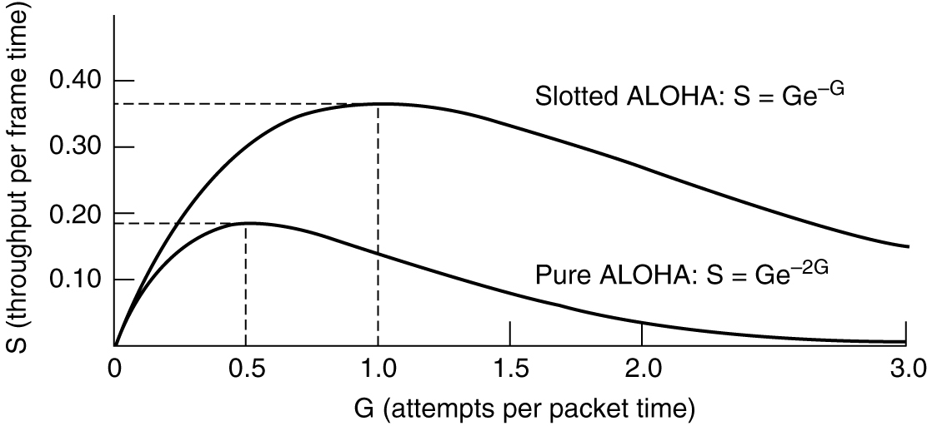
Throughput versus offered traffic
Operating at higher values of G reduces the number of empties but increases the number of collisions exponentially. For slotted ALOHA systems,
As a result of the exponential dependence of E upon G, small increases in the channel load can drastically reduce its performance.
Throughput versus offered traffic for ALOHA systems

Slide 21
Example
Measurement of a slotted ALOHA channel with an infinite number of users show that 20 percent of slots are idle .
a) What is the channel load, G?
b) What is the throughput?
c) Is the channel underloaded or overloaded?
a) Poisson distribution: P_{r}[k] = G^{k}e^{-G}/k!
P₀ = e^{-G} = 0.2, so G = -lnP₀ = -ln 0.2 = 1.6
b) S = G*e^{-G} = G*0.2 = 1.6*0.2 = 0.32
c) G = 1.6 > 1, so the channel is overloaded.

Slide 22
Carrier Sense Multiple Access Protocols
Persistent and nonpersistent CSMA
1-persistent CSMA (Carrier Sense Multiple Access)
Nonpersistent CSMA
p-persistent CSMA
CSMA with collision detection
Known as CSMA/CD (CSMA with Collision Detection)
Basis of the classic Ethernet LAN

Slide 23
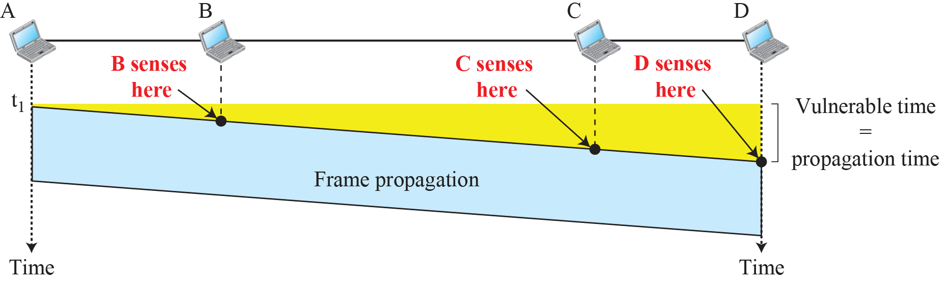
CSMA
CSMA improves on ALOHA by sensing the channel!
User doesn’t send if it senses someone else
Based on the principle “sense before transmit” or “listen before talk.”
讲前先听
Notes:
802.11 uses a refinement of p-persistent CSMA

Slide 24
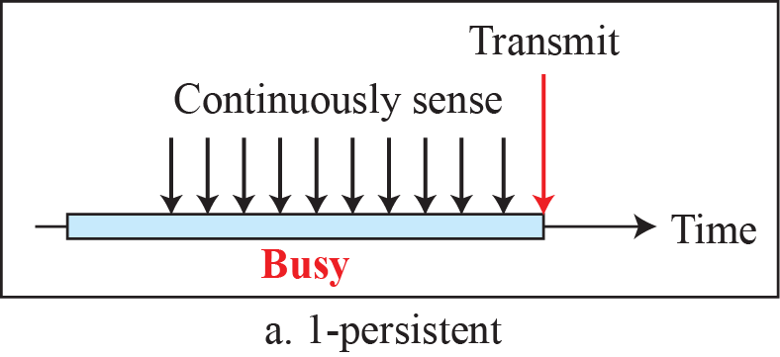
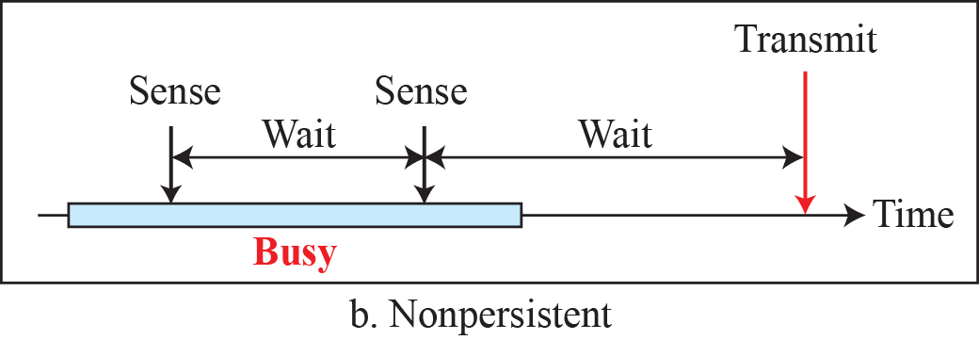
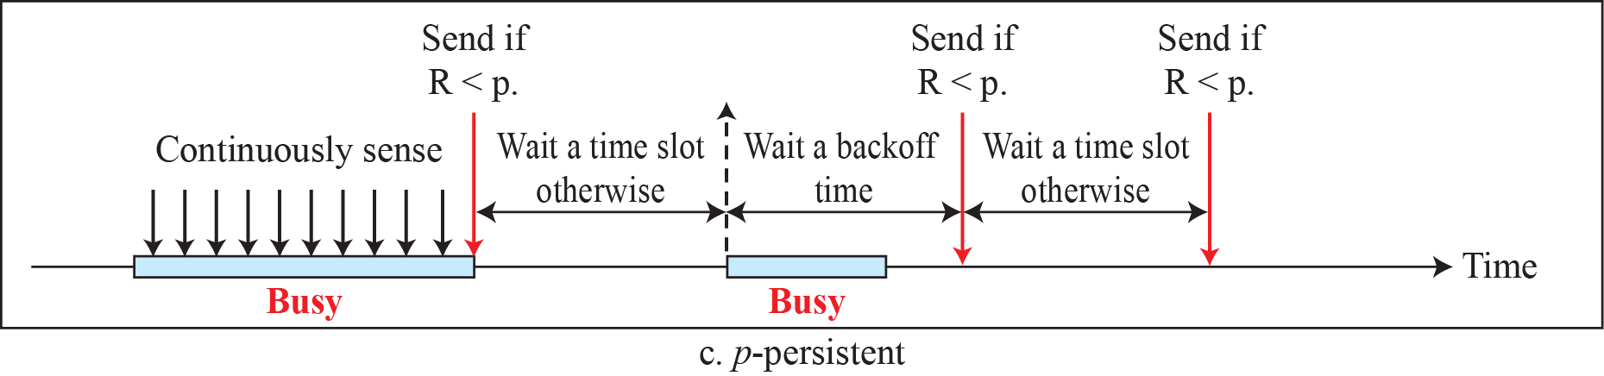
Behavior of three persistence methods
Variations on what to do if the channel is busy:
1-persistent (greedy) sends as soon as idle
Nonpersistent waits a random time then tries again
p-persistent sends with probability p when idle

Slide 25
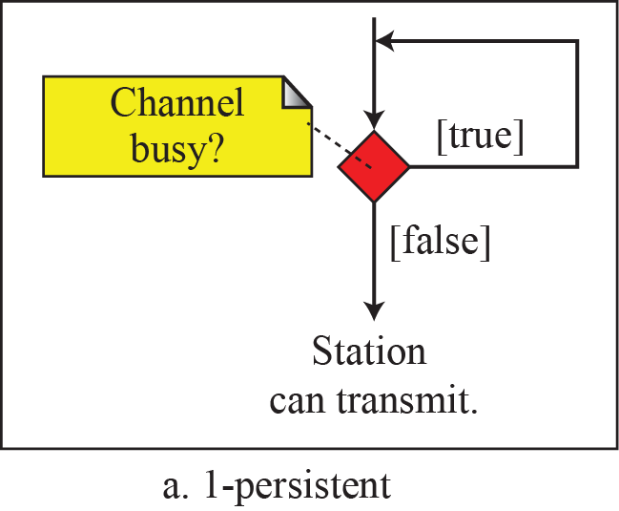
1-persistent CSMA
When a station has data to send, it first listens to the channel to see if anyone else is transmitting at that moment.
If the channel is idle, the stations sends its data. (with a probability of 1)
if the channel is busy, the station just waits until it becomes idle (persistent). Then the station transmits a frame.
If a collision occurs, the station waits a random amount of time and starts all over again.
冲突的两种可能情景：
1.信号传播延迟造成的冲突；如第一个站的信号还没到达第二个站，第二个站则会认为信道空闲，会立即发送数据；
2.多个站点同时监听到信道空闲，同时发送。

Slide 26
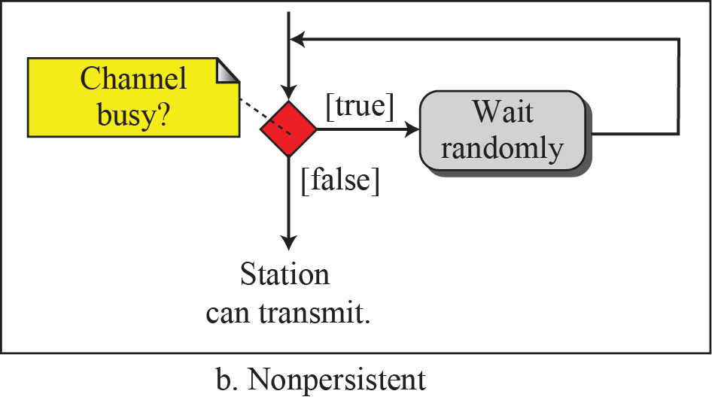
Nonpersistent CSMA
A station senses the channel when it wants to send a frame,
if no one else is sending, the station begins doing so itself.
if the channel is already in use, the station does not continually sense it (nonpersistent). Instead, it waits a random period of time and then repeats the algorithm.
Better channel utilization but longer delays than 1-persistent CSMA.

Slide 27
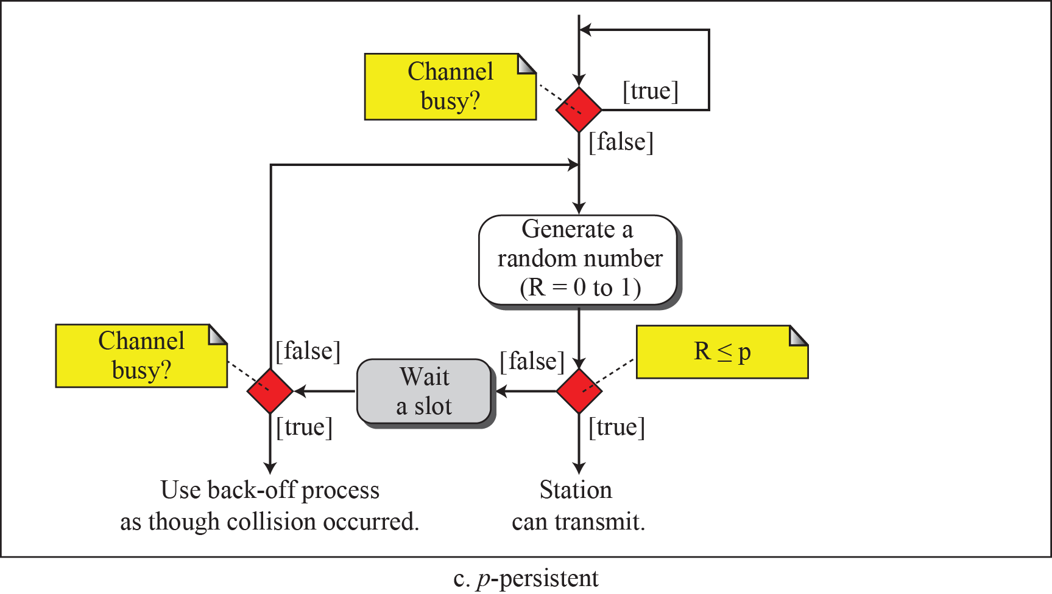
p-persistent CSMA
When a station becomes ready to send, it senses the channel.
If it is idle, it transmits with a probability p. With a probability q = 1 − p, it defers until the next slot.
If that slot is also idle, it either transmits or defers again, with probabilities p and q. This process is repeated until either the frame has been transmitted or another station has begun transmitting.
It applies to slotted channels.
IEEE 802.11 uses a refinement of p-persistent CSMA
概率p：降低1-persistent CSMA中多个站点同时发送而造成冲突的概率
坚持监听：克服non-persistent CSMA中造成的时间延迟
p的选择直接关系到协议的性能

Slide 28
Flow diagram for three persistence methods

Slide 29
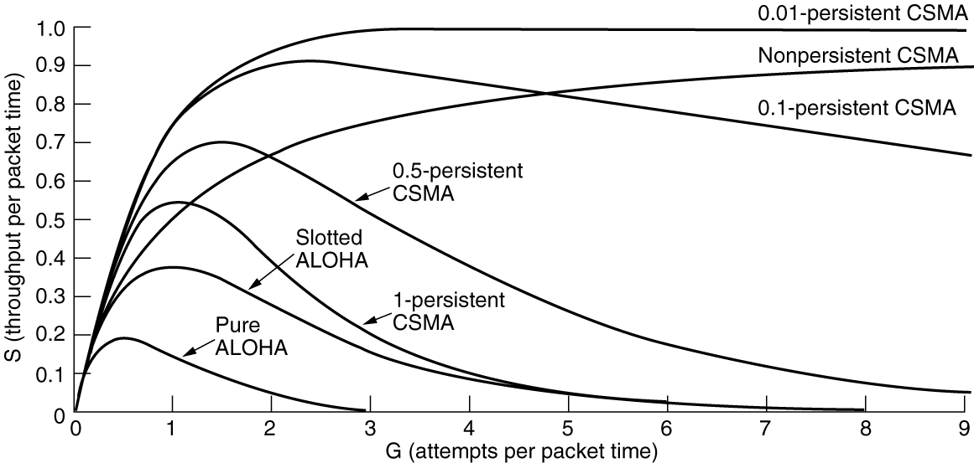
Persistent and Nonpersistent CSMA
CSMA outperforms ALOHA, and being less persistent is better under high load.
“先听后发”机制在发送过程中如果发生冲突，仍要将剩余的无效数据发送完，浪费时间和带宽。
Comparison of the channel utilization versus load for various random access protocols

Slide 30
CSMA with Collision Detection (1)
CSMA/CD improvement is to detect/abort collisions
A station monitors the medium after it sends a frame to see if the transmission was successful.
冲突检测：通过检测回复信号的能量或者脉冲宽度并将之与发送的信号做比较，如果信号不同，就可以判断发生冲突。
发送前监听信道，若闲则发送数据；若忙则一直监听信道直至空闲，开始发送数据；
发送数据时边发送边监听信道，若未检测到冲突，则发送完成。一旦检测到冲突，立即停止发送数据，发送一串阻塞信号（jamming signal），并等待一随机时间后再重新尝试发送。
Notes:
jamming signal：让所有用户都知道现在已经发生了冲突。

Slide 31
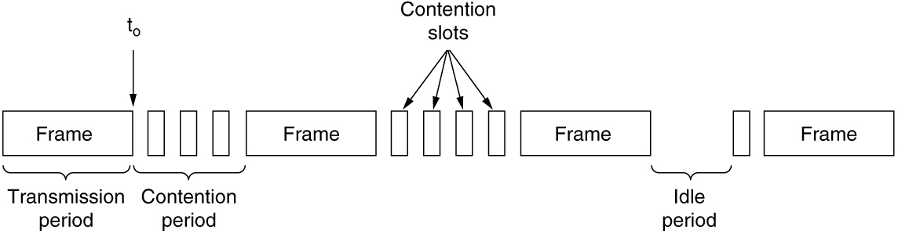
CSMA with Collision Detection (2)
CSMA/CD is the basis of the classic Ethernet LAN.
讲前先听
+
边讲边听
CSMA/CD can be in transmission, contention, or idle state

Slide 32
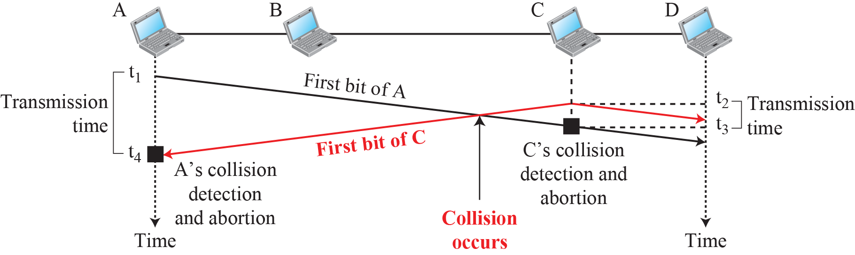
Collision of the first bit in CSMA/CD

Slide 33
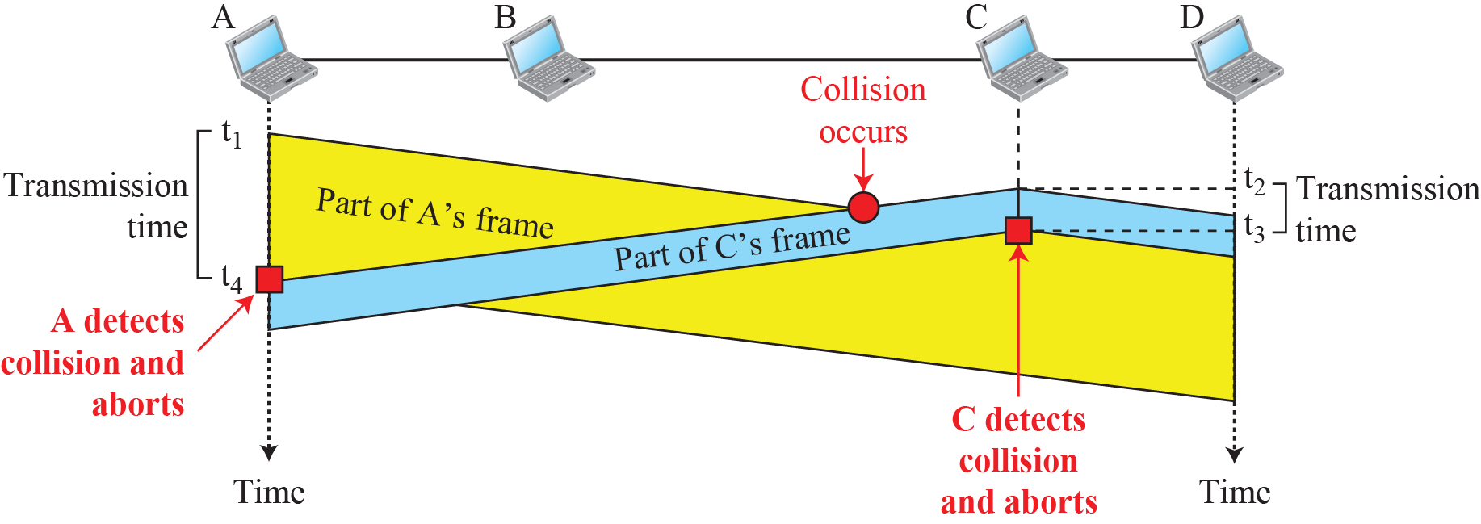
Collision and abortion in CSMA/CD

Slide 34
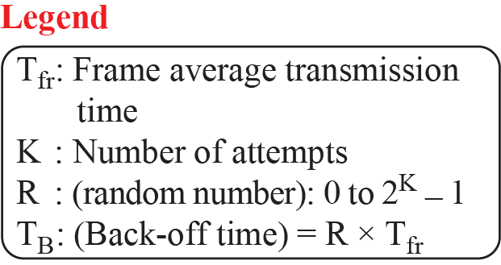
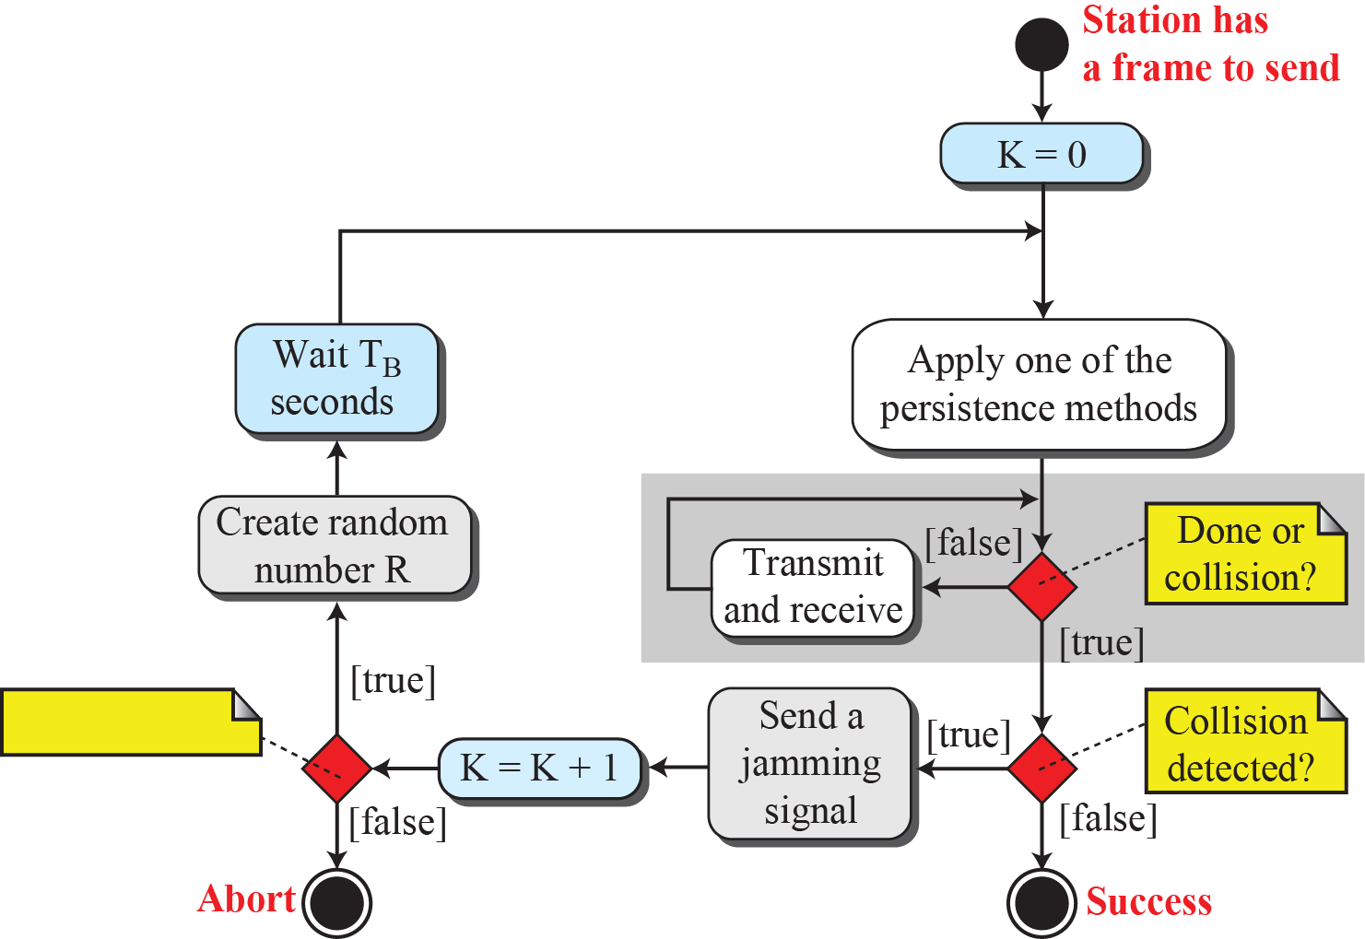
Flow diagram for CSMA/CD

Slide 35
Collision Detection
In CSMA/CD,
It is the responsibility of the transmitting station to detect the collision.
To detect the collision in CSMA/CD, each station must follow the condition:
Transmission delay >= 2 * Propagation delay
According to this condition,
Each station must transmit the data packet of size whose transmission delay is at least twice its propagation delay.
If the size of data packet is smaller, then collision detection would not be possible.
Length of Data Packet,
Transmission delay = Length of data packet (L) / Bandwidth (B).
Propagation delay = Distance between the two stations (D) / Propagation speed (V)
We get L / B >= 2 * D / V.
Thus,
L >= 2 * B * D / V

Slide 36
Example
A network using CSMA/CD has a bandwidth of 10 Mbps. If the maximum propagation time (including the delays in the devices and ignoring the time needed to send a jamming signal) is 25.6 μs, what is the minimum size of the frame?
Solution
The minimum frame transmission time is 2 × T_{p} = 51.2 μs.
This means, in the worst case, a station needs to transmit for a period of 51.2 μs to detect the collision.
The minimum size of the frame is 10 Mbps × 51.2 μs = 512 bits or 64 bytes.
This is actually the minimum size of the frame for Standard Ethernet, as we will see later in the chapter.

Slide 37
Collision-Free Protocols
Bit-map protocol
Basic bit-map method
Reservation protocols
The desire to transmit is broadcast before the actual transmission
Token passing
Token bus
FDDI (Fiber Distributed Data Interface)
RPR (Resilient Packet Ring)
Defined as IEEE 802.17 to standardize the mix of metropolitan area rings in use by ISPs
Binary countdown

Slide 38
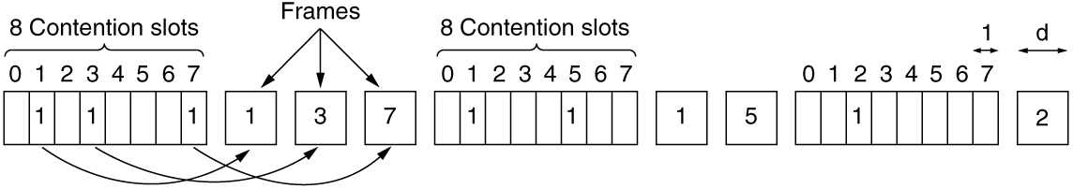
A Bit-Map Protocol
Collision-free protocols avoid collisions entirely
Senders must know when it is their turn to send
The basic bit-map protocol:
Sender set a bit in contention slot if they have data
Senders send in turn; everyone knows who has data
The basic bit-map protocol

Slide 39
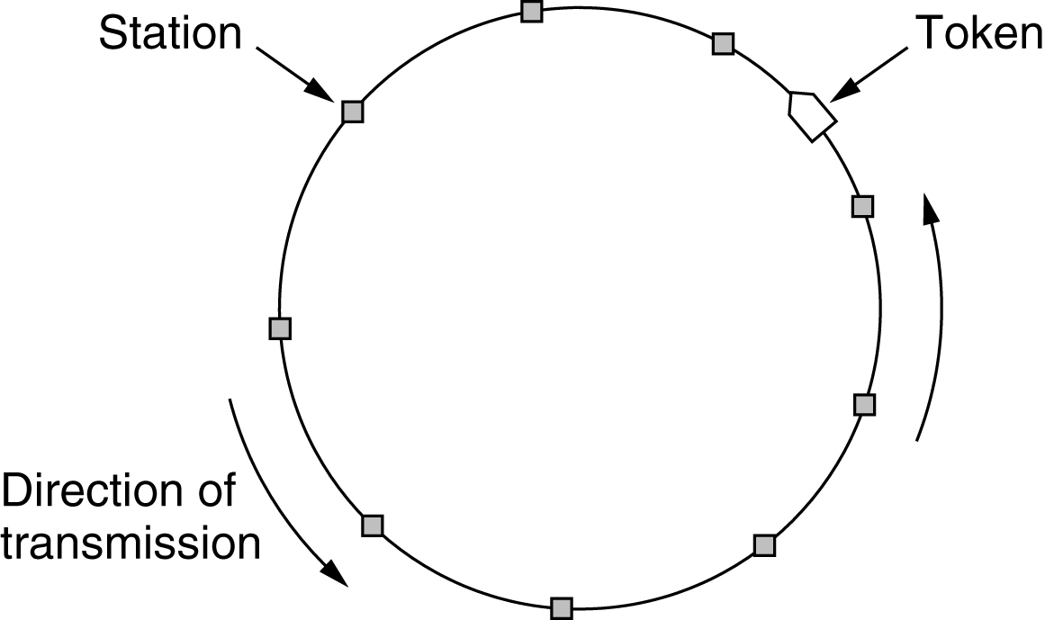
Token Passing
The stations in a network are organized in a logical ring. For each station, there is a predecessor and a successor.
The predecessor is the station which is logically before the station in the ring
The successor is the station which is after the station in the ring.
Token sent round ring defines the sending order
Station with token may send a frame before passing
Idea can be used without ring too, e.g., token bus
Token ring

Slide 40
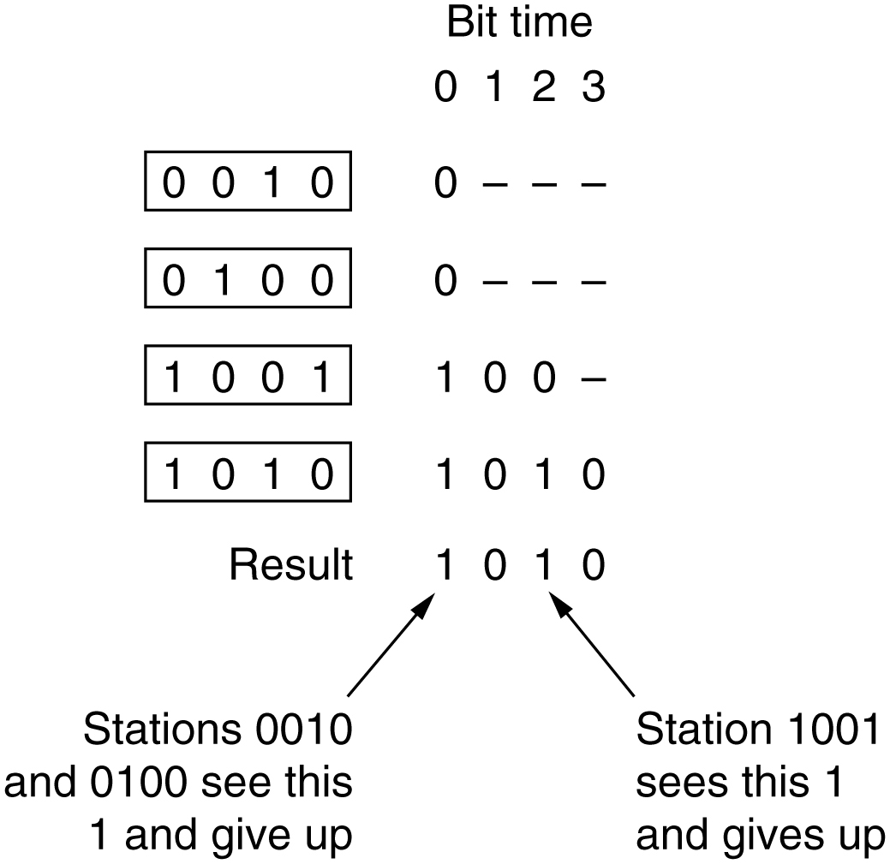
Binary Countdown
Stations send their address in contention slot (log N bits instead of N bits)
Medium ORs bits; stations give up when they send a “0” but see a “1”
Station that sees its full address is next to send
The binary countdown protocol. A dash indicates silence.

Slide 41
Limited-Contention Protocols (1 of 2)
Combines the best properties of the contention and collision-free protocols
Limited-contention protocol
Use contention at low load to provide low delay
Used a collision-free technique at high load to provide good channel efficiency
Asymmetric protocols
Review performance of the symmetric protocols first
The adaptive tree-walk protocol

Slide 42
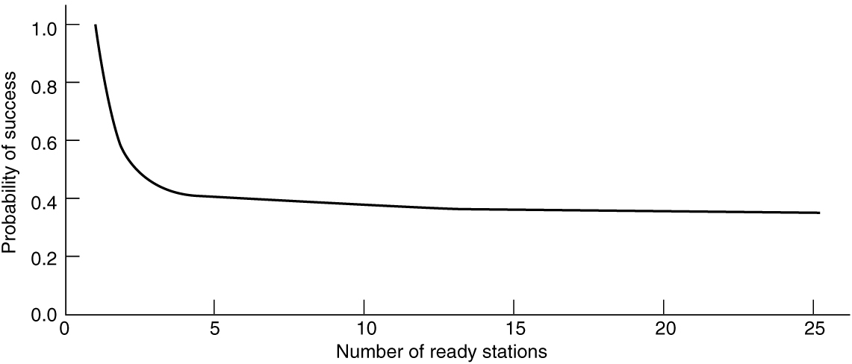
Limited-Contention Protocols (2 of 2)
Idea is to divide stations into groups within which only a very small number are likely to want to send
Avoids wastage due to idle periods and collisions
Already too many contenders for a good chance of one winner
Acquisition probability for a symmetric contention channel

Slide 43
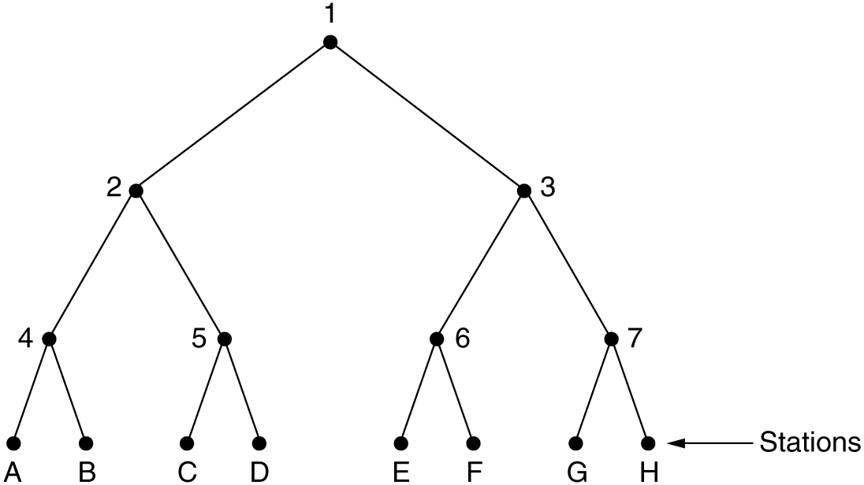
The Adaptive Tree-Walk Protocol
Tree divides stations into groups (nodes) to poll
Depth first search under nodes with poll collisions
Start search at lower levels if >1 station expected
At what level in the tree should the search begin?
Each node at level I has a fraction 2^{-i} of the stations below it.
If the number of ready stations is q and uniformly distributed, the mean number of contending stations per slot is 1. i.e., 2^{-i} q = 1
i =log₂q
Level 0
Level 1
Level 2
The tree for eight stations
Notes:
the expected number of them below a specific node at level i is just 2^{-i} q.
Intuitively, we would expect the optimal level to begin searching the tree to be the one at which the mean number of contending stations per slot is 1. i.e., 2^{-i} q = 1, we can get i =log₂q

Slide 44
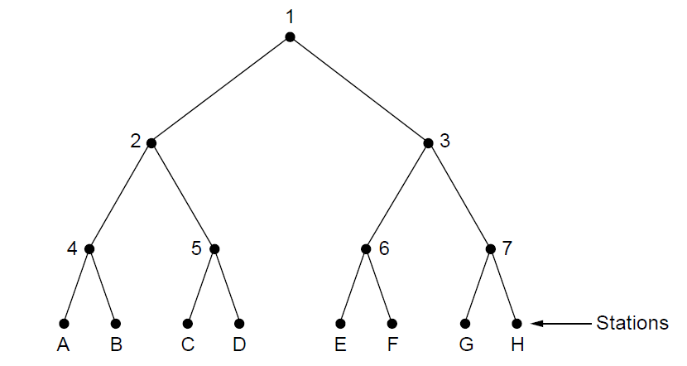
Adaptive Tree Walk：Example
A、G要求发送(uniform distributed)
q = 2, i =log₂q = log₂2 = 1
Slot0：冲突（ level0 ，节点1下所有站）；
Slot1：level1左子树(节点2下所有站)，A成功；
Slot2：level1右子树(节点3下所有站)，G成功；
A、C要求发送
Slot0：冲突（ level0 ，节点1下所有站） ；
Slot1：冲突（leve1，节点2下所有站）；
Slot2：level2左子树（节点4下所有站），A成功；
Slot3：level2右子树（节点5下所有站），C成功；
C、D要求发送
Slot0：冲突（ level0 ，节点1下所有站）；
Slot1： level1左子树(节点2下所有站)，冲突；
slot2： level2左子树（节点4下所有站），空闲；
Slot3： level2右子树（节点5下所有站），冲突；
Slot4：左叶子节点，C成功;
Slot5：右叶子节点，D成功;
Level 0
Level 1
Level 2

Slide 45
Wireless LAN Protocols
Wireless has complications compared to wired.
Nodes may have different coverage regions
Leads to hidden and exposed terminals
Nodes can’t detect collisions, i.e., sense while sending
Makes collisions expensive and to be avoided

Slide 46
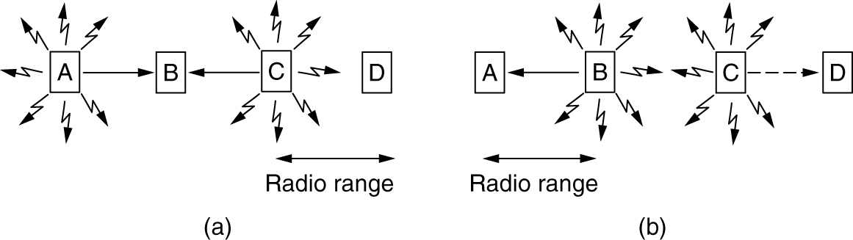
Hidden Terminals and Exposed Terminals
Hidden terminals: senders that cannot sense each other but nonetheless collide at intended receiver
Want to prevent;
loss of efficiency
Exposed terminals: senders who can sense each other but still transmit safely (to different receivers)
Desirably concurrency;
improves performance
B → A and C → D
A wireless LAN. (a) A and C are hidden terminals when transmitting to B. (b) B and C are exposed terminals when transmitting to A and D.

Slide 47
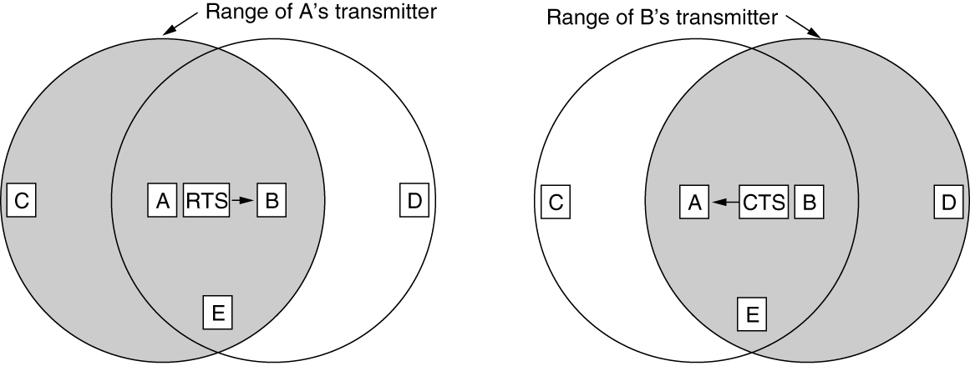
Wireless LAN Protocols (2 of 2)
发送站点发送请求短帧（RTS）触发接收站点发送应答短帧（CTS），使接收站点周围的站点监听到CTS帧，在一定时间内避免发送数据。
未采用载波侦听机制。
A向B发送RTS（Request To Send）帧，A周围的站点在一定时间内不发送数据，以保证CTS帧返回给A；
B向A回答CTS（Clear To Send）帧，B周围的站点在一定时间内不发送数据，以保证A发送完数据；
A开始发送 –若发生冲突(两站点同时发送RTS)，则等待随机时间，再重试。
The MACA protocol. (a) A sending an RTS to B. (b) B responding with a CTS to A.
Notes:
MACA protocol grants access for A to send to B:
A sends RTS to B [left]; B replies with CTS [right]
A can send with exposed but no hidden terminals

Slide 48
The Medium Access Control Sublayer Chapter 4
The Channel Allocation Problem
Multiple Access Protocols
Ethernet
Wireless LANs
Bluetooth
DOCSIS
Data Link Layer Switching
Summary

Slide 49
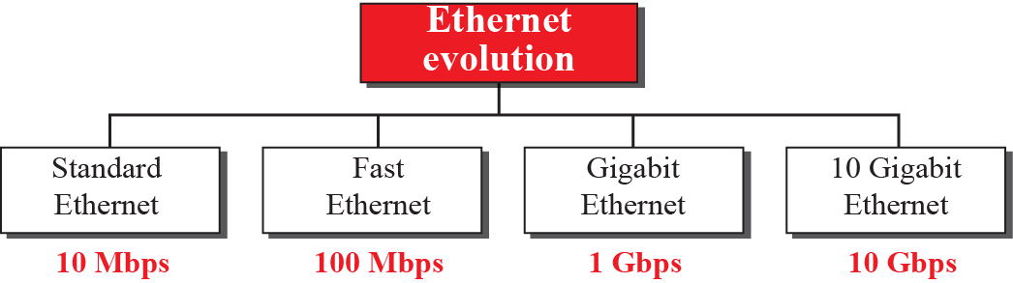
Ethernet (1 of 2)
Classic Ethernet physical layer
Classic Ethernet MAC sublayer protocol
CSMA/CD with binary exponential backoff
Ethernet performance
Switched Ethernet
Fast Ethernet
802.3
802.3u
802.3z
802.3ae

Slide 50
Ethernet (2 of 2)
Gigabit Ethernet
10-Gigabit Ethernet
40- and 100-Gigabit Ethernet
Retrospective on Ethernet

Slide 51
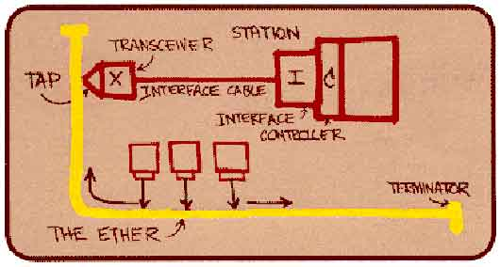
Ethernet
“Dominant” LAN technology developed in the 1970s by Robert Metcalfe and David Boggs.
First widely used LAN technology
Simpler, cheaper than token LANs and ATM
Kept up with speed race: 10, 100, 1000 Mbps 10Gbps, …
Metcalfe’s Ethernet
sketch

Slide 52
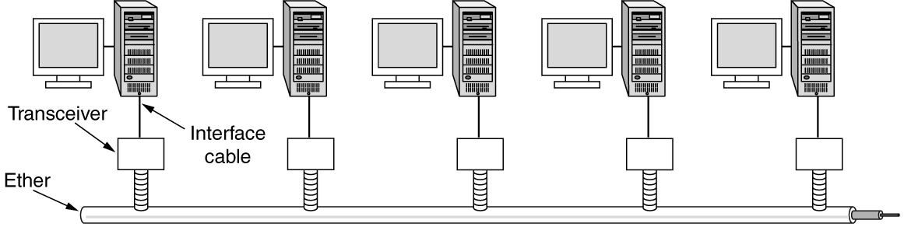
Classic Ethernet Physical Layer
One shared coaxial cable to which all hosts attached
Up to 10 Mbps, with Manchester encoding
Hosts ran the classic Ethernet protocol for access
Architecture of classic Ethernet

Slide 53
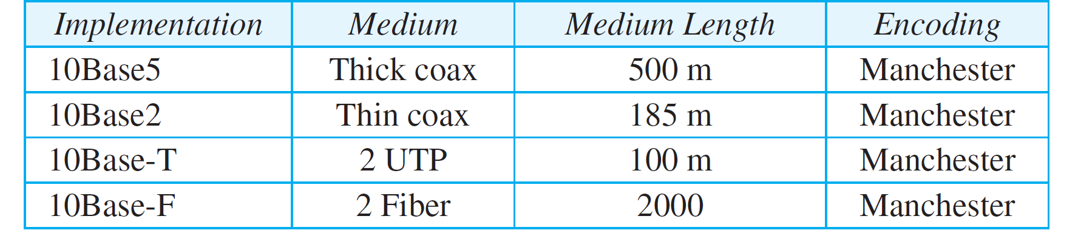
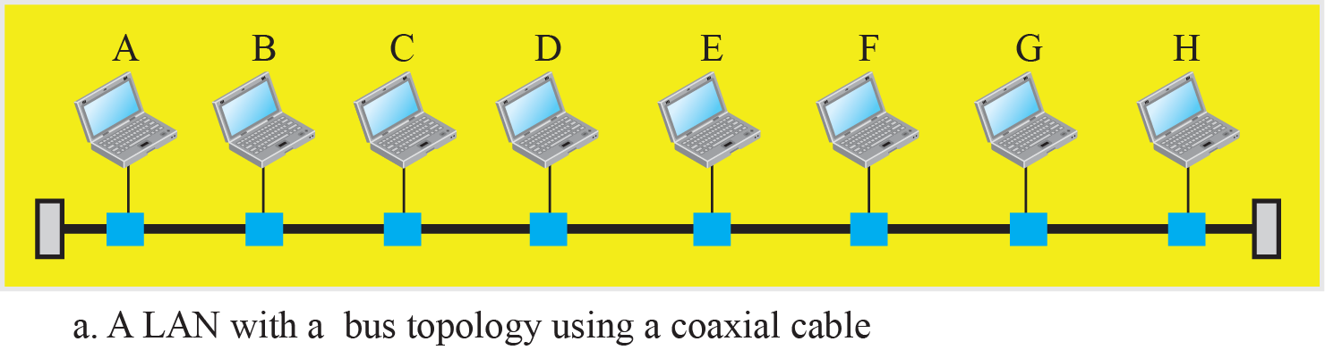
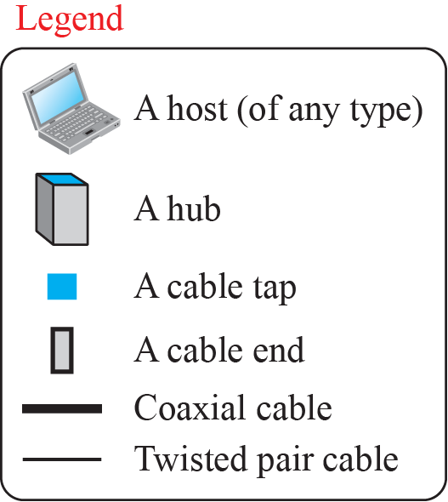
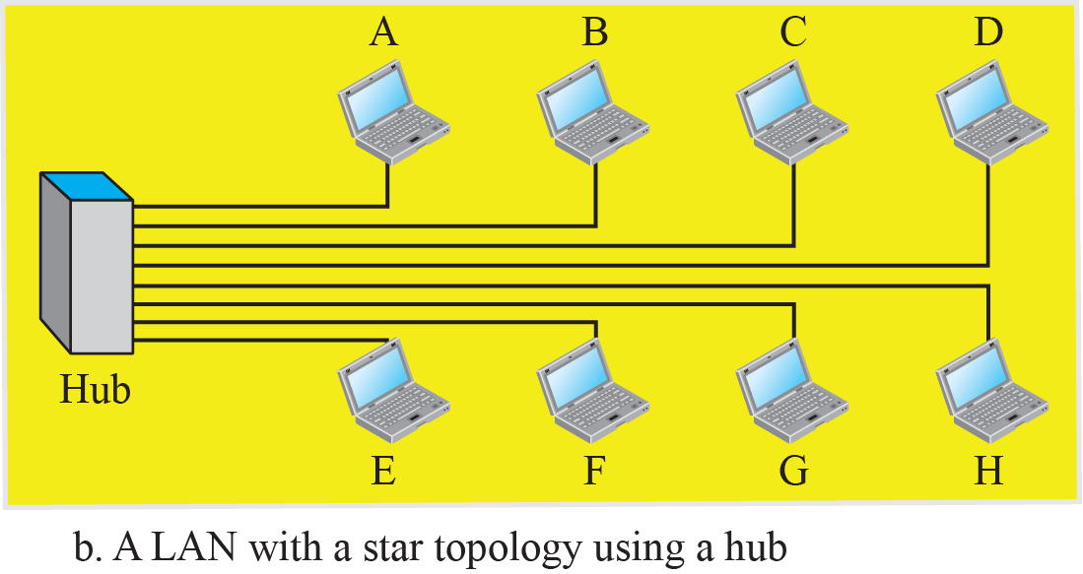
Classic Ethernet – Implementation

Slide 54
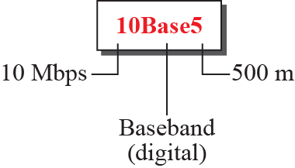
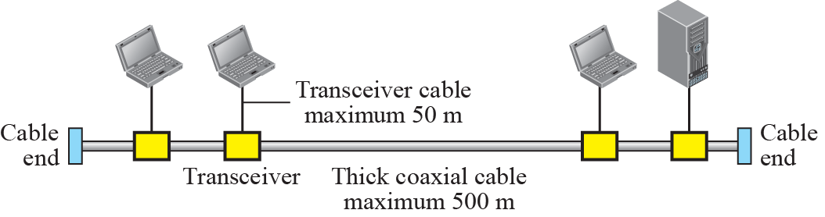
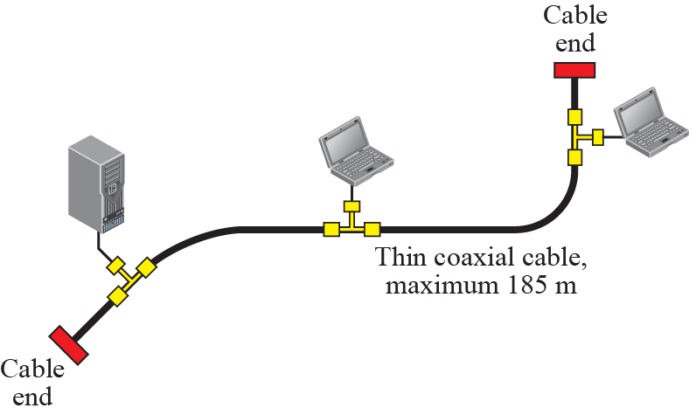
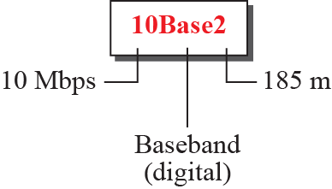
Classic Ethernet – 10Base5 and 10Base2

Slide 55
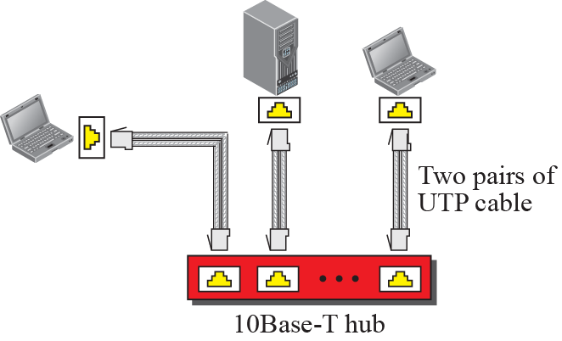
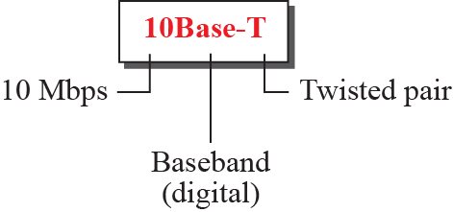
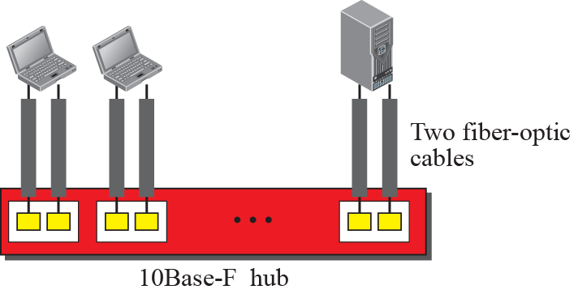
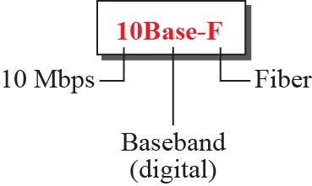
Classic Ethernet – 10BaseT and 10BaseF

Slide 56
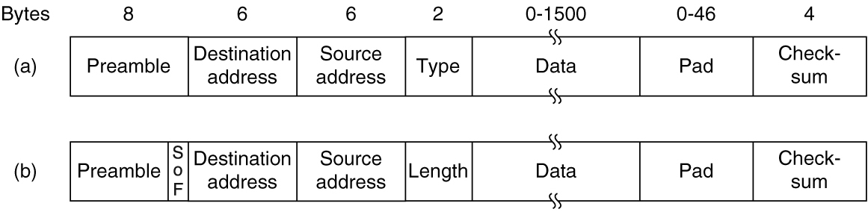
Classic Ethernet Frame Formats
Frame format is still used with modern Ethernet.
Frame formats. (a) Ethernet (DIX). (b) IEEE 802.3.

Slide 57
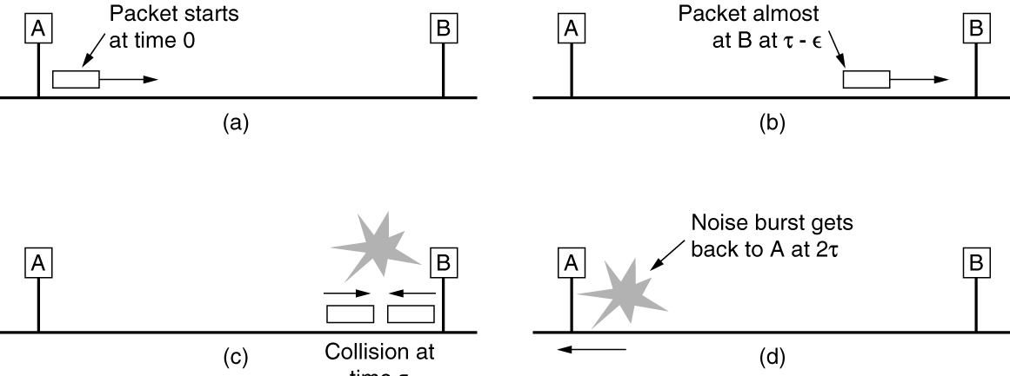
Classic Ethernet MAC Sublayer Protocol
MAC protocol is 1-persistent CSMA/CD (earlier)
Random delay (backoff) after collision is computed with BEB (Binary Exponential Backoff)
Collisions can occur and take as long as 2τ to detect
τ is the time it takes to propagate over the Ethernet
Leads to minimum packet size for reliable detection
Collision detection can take as long as 2 τ.

Slide 58
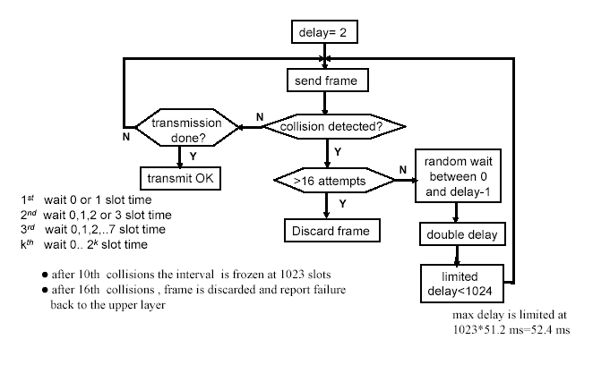
Classic Ethernet – CSMA/CD with BEB

Slide 59
Classic Ethernet – Addressing
Each station on an Ethernet network (such as a PC, workstation, or printer) has its own network interface card (NIC).
The NIC fits inside the station and provides the station with a link-layer address.
The Ethernet address is 6 bytes (48 bits), normally written in hexadecimal notation, with a colon between the bytes. For example, the following shows an Ethernet MAC address:
4A:30:10:21:10:1A
You can use “ipconfig /all” to check the MAC addresses of your PC or laptop.

Slide 60
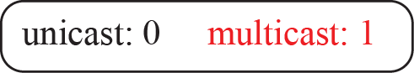
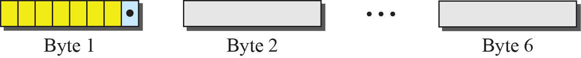
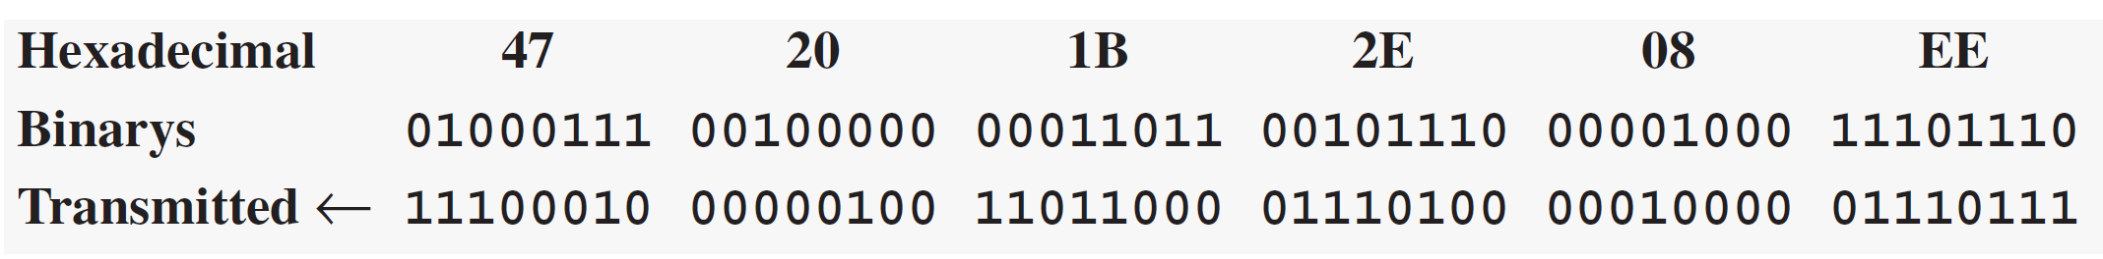
Classic Ethernet – unicast and multicast address
To find the type of the address, we need to look at the second hexadecimal digit from the left.
If it is even, the address is unicast.
If it is odd, the address is multicast.
If all digits are Fs, the address is broadcast.

Slide 61
Example
Define the type of the following destination addresses:
4A:30:10:21:10:1A
47:20:1B:2E:08:EE
FF:FF:FF:FF:FF:FF
Solution
a. This is a unicast address because A in binary is 1010 (even).
b. This is a multicast address because 7 in binary is 0111 (odd).
c. This is a broadcast address because all digits are Fs in
hexadecimal.

Slide 62

Ethernet Performance
Efficient for large frames, even with many senders
Degrades for small frames (and long LANs)
10 Mbps Ethernet,
64 byte min. frame
Efficiency of Ethernet at 10 Mbps with 512-bit slot times

Slide 63


Classic Ethernet – Bandwidth sharing

Slide 64


Collision domains
A bridge is the separation of the collision domain

Slide 65


Full-duplex Switched Ethernet

Slide 66

Switched Ethernet (1 of 2)
Switches isolate each port to a separate domain
Much greater throughput for multiple ports
No need for CSMA/CD with full-duplex lines
Hubs wire all lines into a single CSMA/CD domain
(a) Hub. (b) Switch.

Slide 67

Switched Ethernet (2 of 2)
Switches can be wired to computers, hubs and switches
Hubs concentrate traffic from computers
More on how to switch frames the in 4.8
An Ethernet switch

Slide 68

Fast Ethernet
Fast Ethernet extended Ethernet from 10 to 100 Mbps
The MAC sublayer was left unchanged.
To keep the minimum size of the frame, the maximum length of the network should be 10 times shorter
Twisted pair (with Cat 5) dominated the market
The original fast Ethernet cabling

Slide 69



Encoding for fast Ethernet

Slide 70

Gigabit Ethernet
Switched Gigabit Ethernet is now the garden variety
With full-duplex lines between computers/switches
(a) A two-station Ethernet. (b) A multistation Ethernet.

Slide 71
Gigabit Ethernet – operation mode
The address length, the frame format, and the maximum and minimum frame length are kept the same.
To achieve a data rate of 1 Gbps, this was no longer possible to keep the MAC sublayer untouched.
Gigabit Ethernet has two distinctive approaches for medium access:
half-duplex: used with a hub. CSMA/CD required. The maximum distance is 100 times less than that in classic Ethernet (2500m→25m).
full-duplex: “normal” mode. Used in central switch. buffered. No contention, no CSMA/CD

Slide 72
Gigabit Ethernet – network radius
Two features to the standard to increase the radius:
Carrier extension: tells the hardware to add its own padding after the normal frame(64 bytes) to extend the frame to 512 bytes.
Frame bursting: allows a sender to transmit a concatenated sequence of multiple frames in a single transmission.
These two features extend the radius of the network to 200 meters.

Slide 73

Gigabit Ethernet -implementation
Gigabit Ethernet is commonly run over twisted pair.
Gigabit Ethernet cabling

Slide 74


Encoding in Gigabit Ethernet

Slide 75

10-Gigabit Ethernet
10-Gigabit Ethernet cabling
SR表示短距离,
LR表示长距离,
ER 表示超长距离

Slide 76
The Medium Access Control Sublayer Chapter 4
The Channel Allocation Problem
Multiple Access Protocols
Ethernet
Wireless LANs
Bluetooth
DOCSIS
Data Link Layer Switching
Summary

Slide 77
Wireless LANs
802.11 architecture and protocol stack
802.11 physical layer
802.11 MAC sublayer protocol
802.11 frame structure
Services

Slide 78

The 802.11 Architecture and Protocol Stack (1 of 2)
802.11 architecture. (a) Infrastructure mode. (b) Ad-hoc mode.

Slide 79

The 802.11 Architecture and Protocol Stack (2 of 2)
Part of the 802.11 protocol stack

Slide 80



Basic Service Set & Extended Service Set

Slide 81
802.11 physical layer
NICs are compatible with multiple physical layers
E.g., 802.11 a/b/g
Name | Technique | Max. Bit Rate
802.11b | Spread spectrum, 2.4 GHz | 11 Mbps
802.11g | OFDM, 2.4 GHz | 54 Mbps
802.11a | OFDM, 5 GHz | 54 Mbps
802.11n | OFDM with MIMO, 2.4/5 GHz | 600 Mbps

Slide 82

Flow Diagram for CSMA/CA
CSMA/CD
节点侦听到信道空闲时立即发送；
CSMA/CA
节点推迟发送，每新尝试一次都要随机回退。避免有多个站同时等待信道空闲，并发现信道空闲后立即发送而造成的冲突。

Slide 83

The 802.11 MAC Sublayer Protocol (1 of 4)
CSMA/CA inserts backoff slots to avoid collisions
MAC uses ACKs/retransmissions for wireless errors
Sending a frame with CSMA/CA

Slide 84

The 802.11 MAC Sublayer Protocol (2 of 4)
(a) The hidden terminal problem. (b) The exposed terminal problem.

Slide 85

The 802.11 MAC Sublayer Protocol (3 of 4)
Virtual channel sensing with the NAV and optional RTS/CTS (often not used) avoids hidden terminals
Virtual channel sensing using CSMA/CA

Slide 86

The 802.11 MAC Sublayer Protocol (4 of 4)
Different backoff slot times add quality of service
Short intervals give preferred access, e.g., control, VoIP
MAC has other mechanisms too, e.g., power save
Interframe spacing in 802.11

Slide 87
帧间间隔IFS (interframe space)
为了尽量避免碰撞，802.11规定，所有的站在完成发送后，必须再等待一段很短的时间（继续监听）才能发送下一帧。这段时间的通称是帧间间隔IFS。帧间间隔的长短取决于该站要发送的帧的类型。高优先级的帧需要等待的时间较短，因此可以优先获得发送权，但低优先级帧就必须等待较长的时间。
SIFS：短帧间间隔，用来间隔需要立即响应的帧，如控制帧(RTS/CTS/ACK)等
AIFS：任意帧间间隔。根据访问类别(即要传输的数据类型)对站点进行优先级排序，AISF的计算公式为：AISF编号*时隙+ SISF；
DIFS：分布协调功能帧间间隔，只能够由工作于DCF模式的站点来使用
PIFS：集中协调功能帧间间隔，只能够由工作于PCF模式的站点来使用
EIFS: 在前一帧出错的情况下，发送节点 不得不延迟 EIFS 而不是DIFS时间段，再发送下一帧。

Slide 88

The 802.11 Frame Structure
Frames vary depending on their type (Frame control)
Data frames have 3 addresses to pass via APs
Format of the 802.11 data frame

Slide 89

Subfields in Frame Control field

Slide 90





Addressing Mechanism

Slide 91
Services
Association and data delivery
Security and privacy
Prioritization and power control

Slide 92
The Medium Access Control Sublayer Chapter 4
The Channel Allocation Problem
Multiple Access Protocols
Ethernet
Wireless LANs
Bluetooth
DOCSIS
Data Link Layer Switching
Summary

Slide 93
Bluetooth
Bluetooth architecture
Bluetooth applications
Bluetooth protocol stack
Bluetooth radio layer
Bluetooth link layers
Bluetooth frame structure
Bluetooth 5

Slide 94

Bluetooth Architecture
Piconet master is connected to slave wireless devices
Slaves may be asleep (parked) to save power
Two piconets can be bridged into a scatternet
Two piconets can be connected to form a scatternet

Slide 95

The Bluetooth Protocol Stack
Profiles give the set of protocols for a given application
25 profiles, including headset, intercom, streaming audio, remote control, personal area network, …
The Bluetooth protocol architecture

Slide 96
Bluetooth Radio / Link Layers
Radio layer
Uses adaptive frequency hopping in 2.4 GHz band
Link layer
TDM with timeslots for master and slaves
Synchronous CO for periodic slots in each direction
Asynchronous CL for packet-switched data
Links undergo pairing (user confirms passkey/PIN) to authorize them before use

Slide 97

The Bluetooth Frame Structure
Time is slotted; enhanced data rates send faster but for the same time; addresses are only 3 bits for 8 devices
Typical Bluetooth data frame at (a) basic and (b) enhanced data rates.

Slide 98
Bluetooth 5
Support for Internet of Things devices
Speed increased from 1 Mbps to 2 Mbps
Message size has gone up from 31 bytes to 255 bytes
Range indoors has gone up from 10 m to 40 m
Power requirements have been reduced slightly
Range of the beacons has gone up slightly
Slightly better security

Slide 99
The Medium Access Control Sublayer Chapter 4
The Channel Allocation Problem
Multiple Access Protocols
Ethernet
Wireless LANs
Bluetooth
DOCSIS
Data Link Layer Switching
Summary

Slide 100
DOCSIS
Overview
MAC sublayer performs channel allocation, configuration of quality of service, unique forwarding model
Uses a standard MAC frame format
Ranging
Cable modem transmits a ranging request
CMTS (headend) determines the network delay to the cable modem and performs necessary power adjustment
Channel bandwidth allocation
Service flows
Request-grant process and low-latency DOCSIS

Slide 101
The Medium Access Control Sublayer Chapter 4
The Channel Allocation Problem
Multiple Access Protocols
Ethernet
Wireless LANs
Bluetooth
DOCSIS
Data Link Layer Switching
Summary

Slide 102
Data Link Layer Switching
Uses of bridges
Learning bridges
Spanning tree bridges
Repeaters, hubs, bridges, switches, routers, and gateways
Virtual LANs
The IEEE 802.1Q standard

Slide 103

Learning Bridges (1 of 3)
A bridge operates as a switched LAN (not a hub)
Computers, bridges, and hubs connect to its ports
(a) Bridge connecting two multidrop LANs. (b) Bridges (and a hub) connecting seven point-to-point stations.

Slide 104
Learning Bridges (2 of 3)
Backward learning algorithm picks the output port:
Associates source address on frame with input port
Frame with destination address sent to learned port
Unlearned destinations are sent to all other ports
Needs no configuration
Forget unused addresses to allow changes
Bandwidth efficient for two-way traffic

Slide 105

Learning Bridges (3 of 3)
Bridges extend the Link layer:
Use but don’t remove Ethernet header/addresses
Do not inspect Network header
Protocol processing at a bridge

Slide 106

Spanning-Tree Bridges (1 of 4)
Bridge topologies with loops and only backward learning will cause frames to circulate for ever
Need spanning tree support to solve problem
Bridges with two parallel links

Slide 107

Spanning-Tree Bridges (2 of 4)
After the algorithm runs:
B1 is the root, two dashed links are turned off
B4 uses link to B2 (lower than B3 also at distance 1)
B5 uses B3 (distance 1 versus B4 at distance 2)
A spanning tree connecting five bridges. The dashed lines are links that are not part of the spanning tree.

Slide 108
Spanning-Tree Bridges (3 of 4)
I think that I shall never see
A graph more lovely than a tree.
A tree whose crucial property Is loop-free connectivity.
A tree which must be sure to span.
So packets can reach every LAN.

Slide 109
Spanning-Tree Bridges (4 of 4)
First the Root must be selected
By ID it is elected.
Least-cost paths from Root are traced
In the tree these paths are placed.
A mesh is made by folks like me
Then bridges find a spanning tree.
-- Radia Perlman
Subset of forwarding ports for data is use to avoid loops
Selected with the spanning tree distributed algorithm by Perlman

Slide 110

Repeaters, Hubs, Bridges, Switches, Routers, and Gateways
Devices are named according to the layer they process
A bridge or LAN switch operates in the Link layer
(a) Which device is in which layer. (b) Frames, packets, and headers.

Slide 111

Virtual LANs (1 of 2)
A building with centralized wiring using hubs and a switch

Slide 112

Virtual LANs (2 of 2)
VLANs (Virtual LANs) splits one physical LAN into multiple logical LANs to ease management tasks
Ports are “colored” according to their VLAN
Two VLANs, gray and white, on a bridged LAN

Slide 113

The IEEE 802.1Q Standard (1 of 2)
Bridges need to be aware of VLANs to support them
In 802.1Q, frames are tagged with their “color”
Legacy switches with no tags are supported
Bridged LAN that is only partly VLAN aware. The shaded symbols are VLAN aware. The empty ones are not.

Slide 114

The IEEE 802.1Q Standard (2 of 2)
802.1Q frames carry a color tag (VLAN identifier)
Length/Type value is 0x8100 for VLAN protocol
The 802.3 (legacy) and 802.1Q Ethernet frame formats

Slide 115
The Medium Access Control Sublayer Chapter 4
The Channel Allocation Problem
Multiple Access Protocols
Ethernet
Wireless LANs
Bluetooth
DOCSIS
Data Link Layer Switching
Summary

Slide 116
Summary (1 of 4)
Some networks have a single channel that is used for all communication. In these networks, the key design issue is the allocation of this channel among the competing stations wishing to use it.
FDM and TDM are simple, efficient allocation schemes when the number of stations is small and fixed and the traffic is continuous.
Both are widely used under these circumstances, for example, for dividing up the bandwidth on telephone trunks.
However, when the number of stations is large and variable or the traffic is fairly bursty—the common case in computer networks—FDM and TDM are poor choices. Numerous dynamic channel allocation algorithms have been devised.

Slide 117
Summary (2 of 4)
The ALOHA protocol, with and without slotting, is used in many derivatives in real systems, for example, in DOCSIS networks.
As an improvement when the state of the channel can be sensed, stations can avoid starting a transmission while another station is transmitting. This technique, carrier sensing, has led to a variety of CSMA protocols for LANs and MANs. It is the basis for classic Ethernet and 802.11 networks.
A class of protocols that eliminates contention altogether, or at least reduces it considerably, has been well known for years.
The bitmap protocol, topologies such as rings, and the binary countdown protocol completely eliminate contention.
The tree-walk protocol reduces it by dynamically dividing the stations into two disjoint groups of different sizes and allowing contention only within one group; ideally that group is chosen so that only one station is ready to send when it is permitted to do so.
Modern versions of MAC protocols, including DOCSIS and Bluetooth, explicitly take steps to avoid contention by assigning transmission intervals to senders.

Slide 118
Summary (3 of 4)
Wireless LANs have the added problems that it is difficult to sense colliding transmissions, and that the coverage regions of stations may differ.
In the dominant wireless LAN, IEEE 802.11, stations use CSMA/CA to mitigate the first problem by leaving small gaps to avoid collisions.
The stations can also use the RTS/CTS protocol to combat hidden terminals that arise because of the second problem, although the overhead of RTS/CTS is so high in practice due to the exposed terminal problem that it is often not used, especially in dense environments. In contrast, many clients now use mechanisms to perform channel selection to avoid contention.
IEEE 802.11 is commonly used to connect laptops and other devices to wireless access points, but it can also be used between devices. Any of several physical layers can be used, including multichannel FDM with and without multiple antennas, and spread spectrum.
Modern versions of 802.11 include security features at the link layer, including support for authentication, as well as advanced encoding to support MIMO transmission.

Slide 119
Summary (4 of 4)
Ethernet is the dominant form of wired LAN.
Classic Ethernet used CSMA/CD for channel allocation on a yellow cable the size of a garden hose that snaked from machine to machine. The architecture has changed as speeds have risen from 10 Mbps to 10 Gbps and continue to climb. Now point-to-point links such as twisted pair are attached to hubs and switches. With modern switches and full-duplex links, there is no contention on the links and the switch can forward frames between different ports in parallel.
With buildings full of LANs, a way is needed to interconnect them all. Plugand-play bridges are used for this purpose. The bridges are built with a backward learning algorithm and a spanning tree algorithm. Since this functionality is built into modern switches, the terms ‘‘bridge’’ and ‘‘switch’’ are used interchangeably. To help with the management of bridged LANs, VLANs let the physical topology be divided into different logical topologies. The VLAN standard, IEEE 802.1Q, introduces a new format for Ethernet frames.

Slide 120

Copyright
This work is protected by United States copyright laws and is provided solely for the use of instructors in teaching their courses and assessing student learning. Dissemination or sale of any part of this work (including on the World Wide Web) will destroy the integrity of the work and is not permitted. The work and materials from it should never be made available to students except by instructors using the accompanying text in their classes. All recipients of this work are expected to abide by these restrictions and to honor the intended pedagogical purposes and the needs of other instructors who rely on these materials.

